Slide 1
Ng directives-Angular and Event Binding
22/4/24

Slide 2
NG Directives
"ng directives" likely refers to Angular directives. In Angular, directives are a way to extend the HTML vocabulary, creating custom elements and attributes that can add behavior and functionality to HTML elements. There are three types of directives in Angular:
Component Directives: These are the most common directives and are used to create reusable components. Components are directives with a template.
Attribute Directives: These are used to change the appearance or behavior of a DOM element, component, or another directive. They are applied as attributes to elements in the template.
Structural Directives: These alter the layout of the DOM by adding, removing, or manipulating elements. They are typically prefixed with an asterisk (*) and affect the structure of the DOM.

Slide 3
Component Directive
import { Component } from '@angular/core';
@Component({
selector: 'app-custom-component',
template: '<h1>Hello, {{ name }}</h1>'
})
export class CustomComponent {
name = 'Angular';
}
In this example, CustomComponent is a directive with a template. It can be used as a custom HTML element <app-custom-component></app-custom-component>.

Slide 4
Structural Directive:
<div *ngIf="isLoggedIn; else notLoggedIn">
Welcome, {{ username }}!
<button (click)="logout()">Logout</button>
</div>
<ng-template #notLoggedIn>
<button (click)="login()">Login</button>
</ng-template>
In this example, the *ngIf directive is a structural directive. It conditionally renders the content based on the value of isLoggedIn. If isLoggedIn is true, it displays the logged-in user's information; otherwise, it shows a login button. The else keyword with ng-template provides an alternative template for the *ngIf directiv

Slide 5
NGSTYLE -WORKING
Step 1- First of all, you have to create one component
Ng g c style1
Then you will be able to see four file created style1.component.html,style1.component.ts
Style1.component.css
style1.component.spec.ts

Slide 6
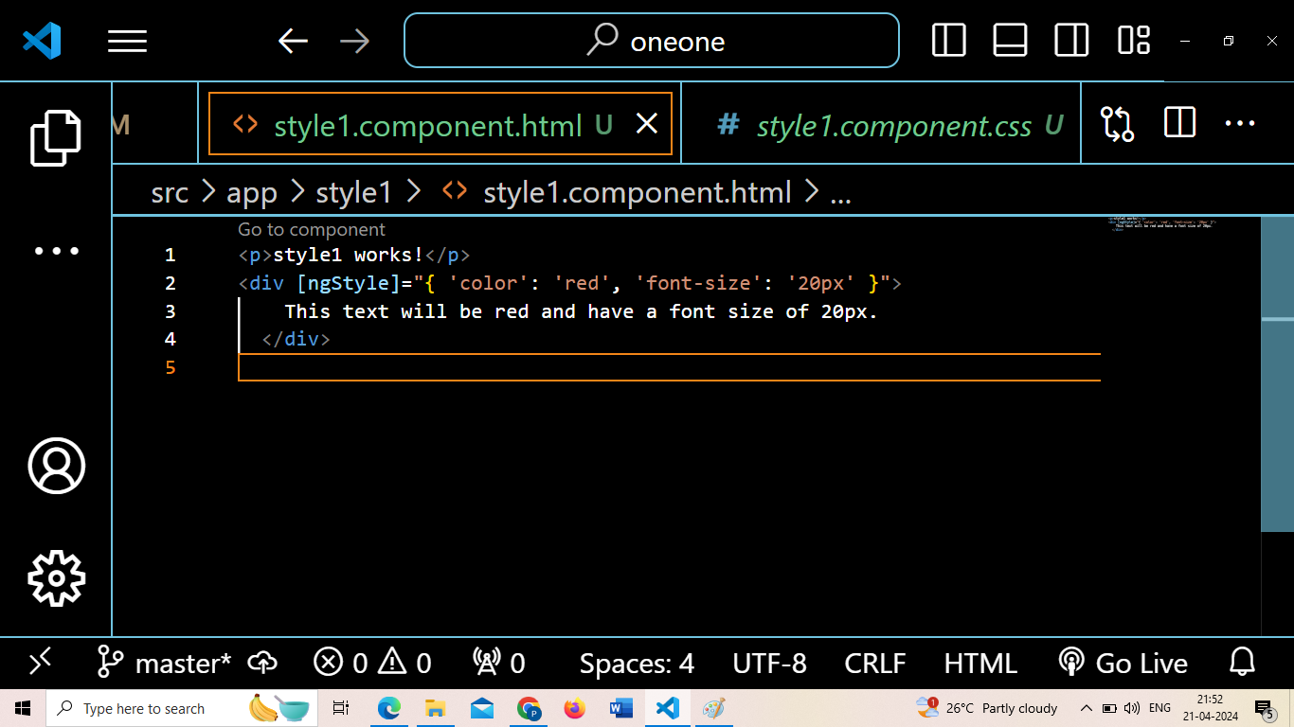
Make use of [ngStyle] in your component.html(created component)

Slide 7
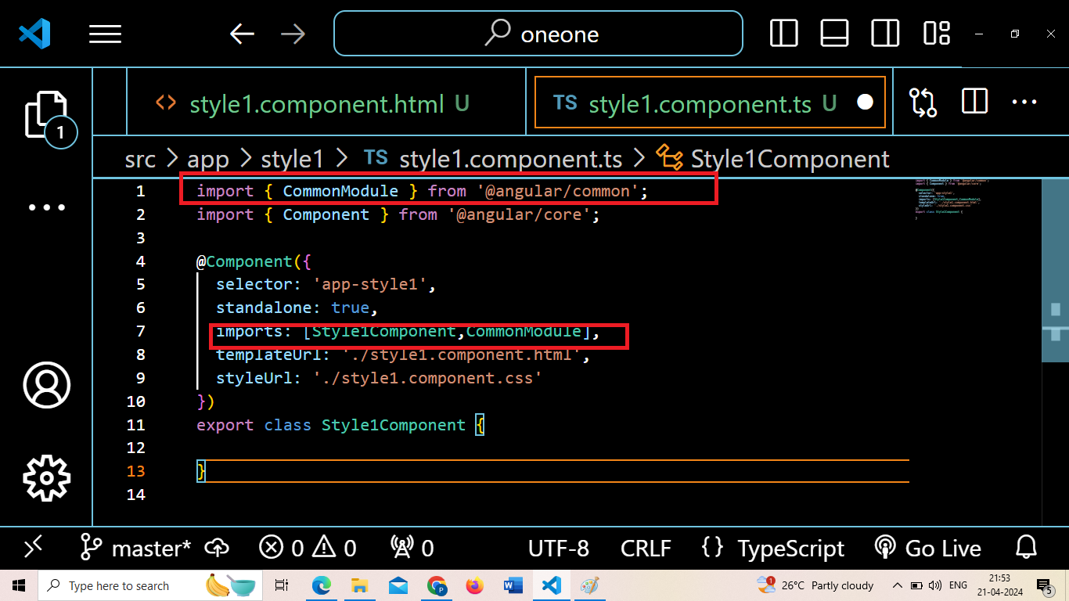
Import common module and compone

Slide 8
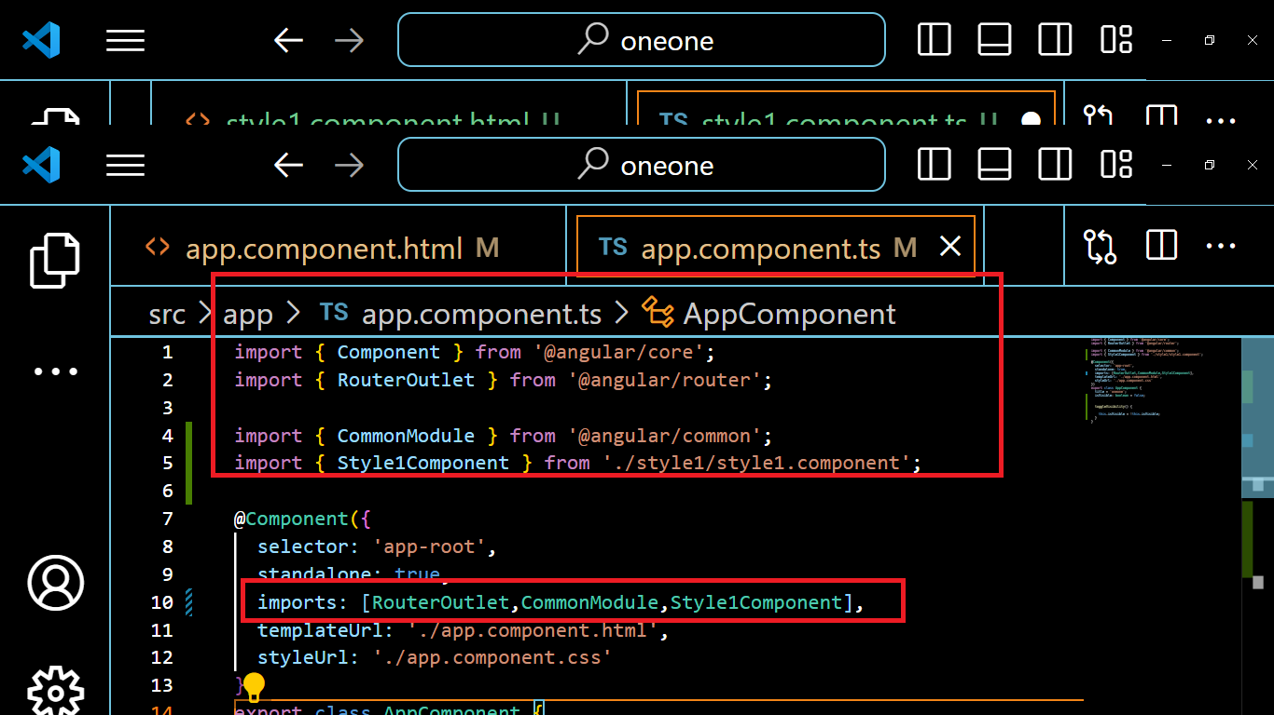
Open app.component.ts

Slide 9
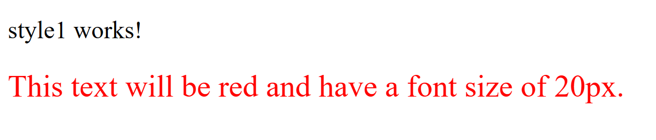

Slide 10
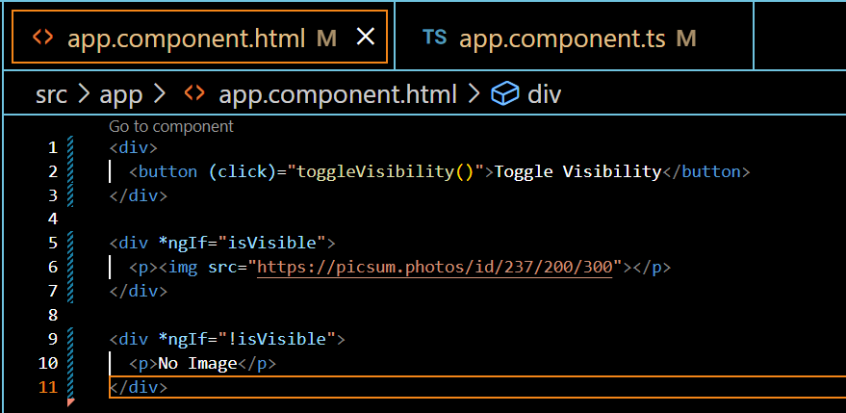
Directive-NgIf

Slide 11
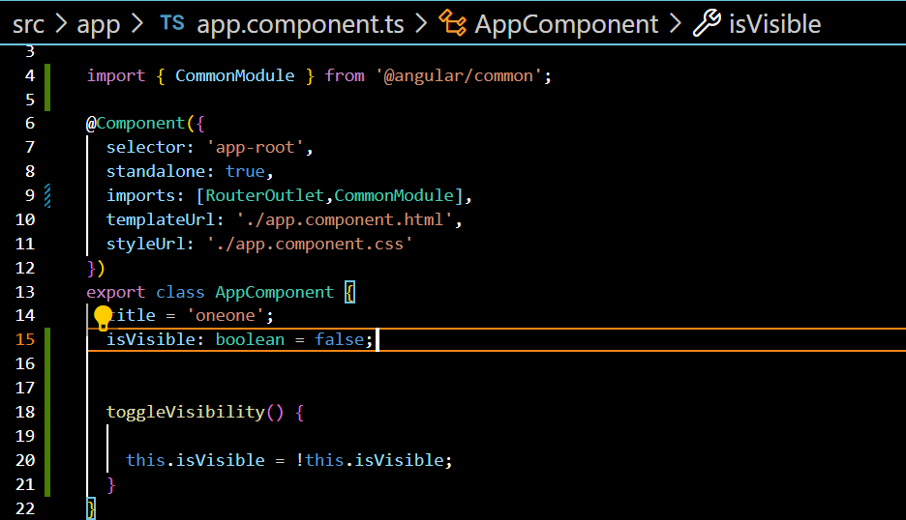

Slide 12
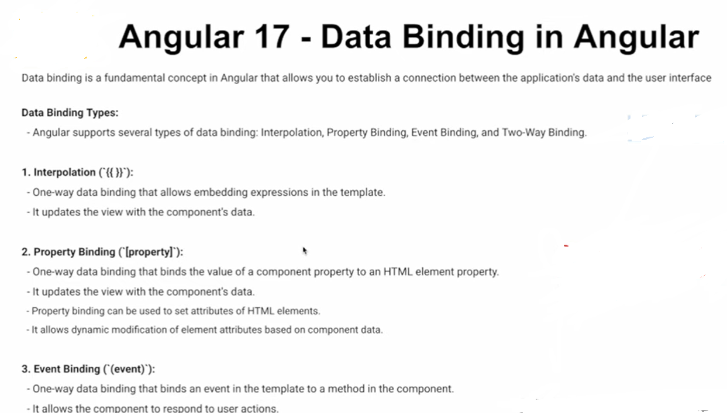
Data Binding

Slide 13
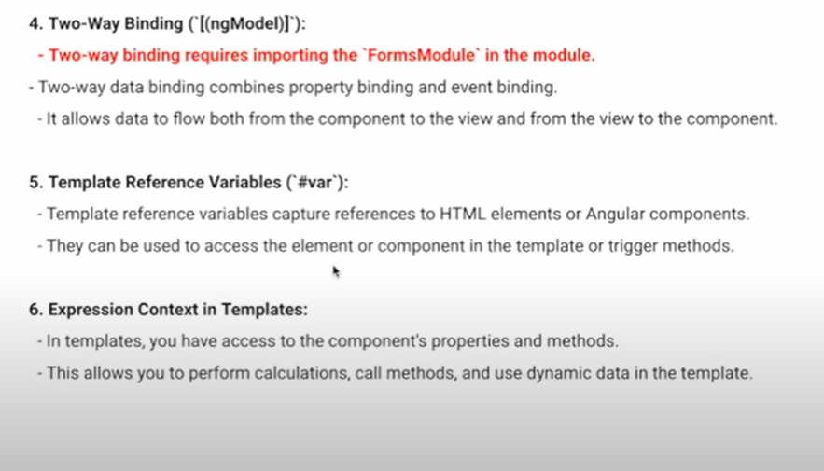
Two way binding

Slide 14
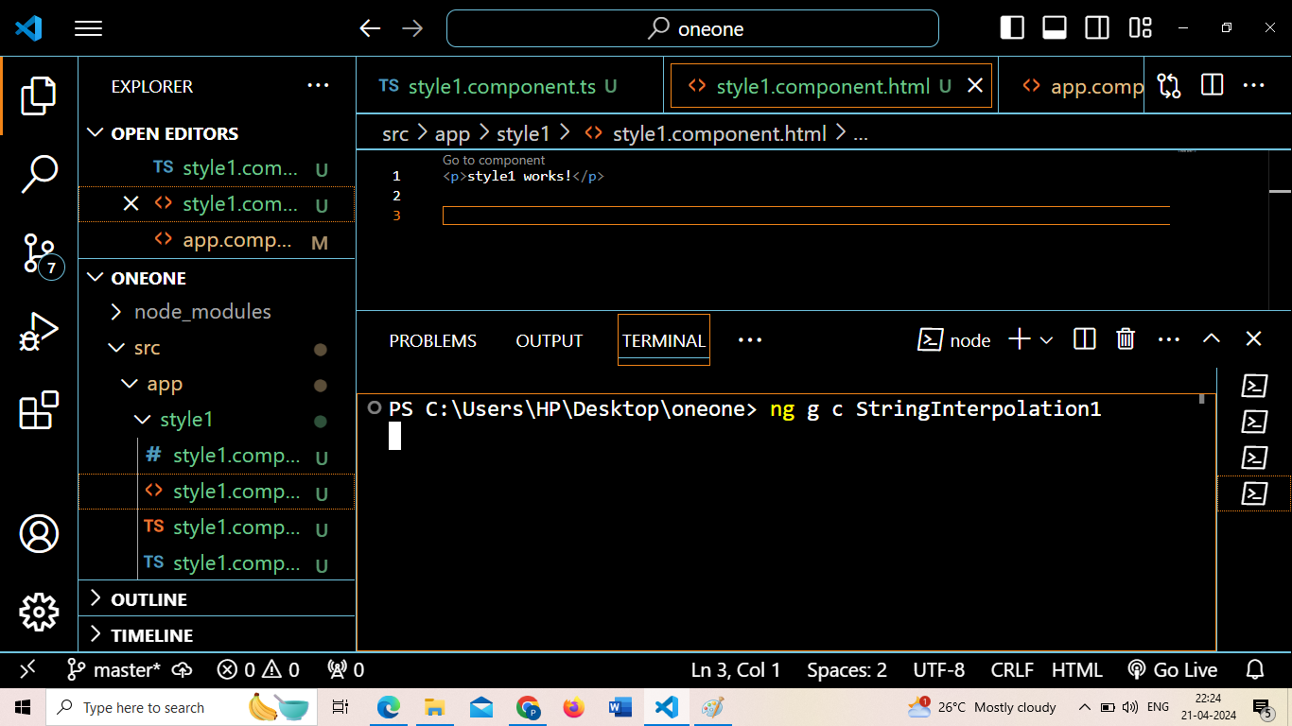
Create one component first, its your choice whether you want to create component with –no-standalone or either you can create directly as well

Slide 15
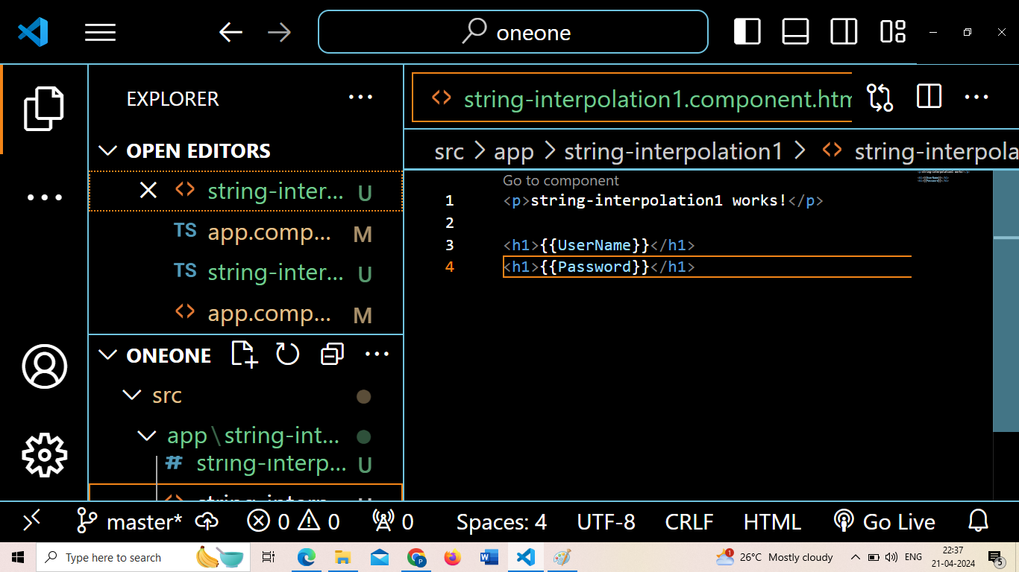
Open stringinterpolation.component.html

Slide 16
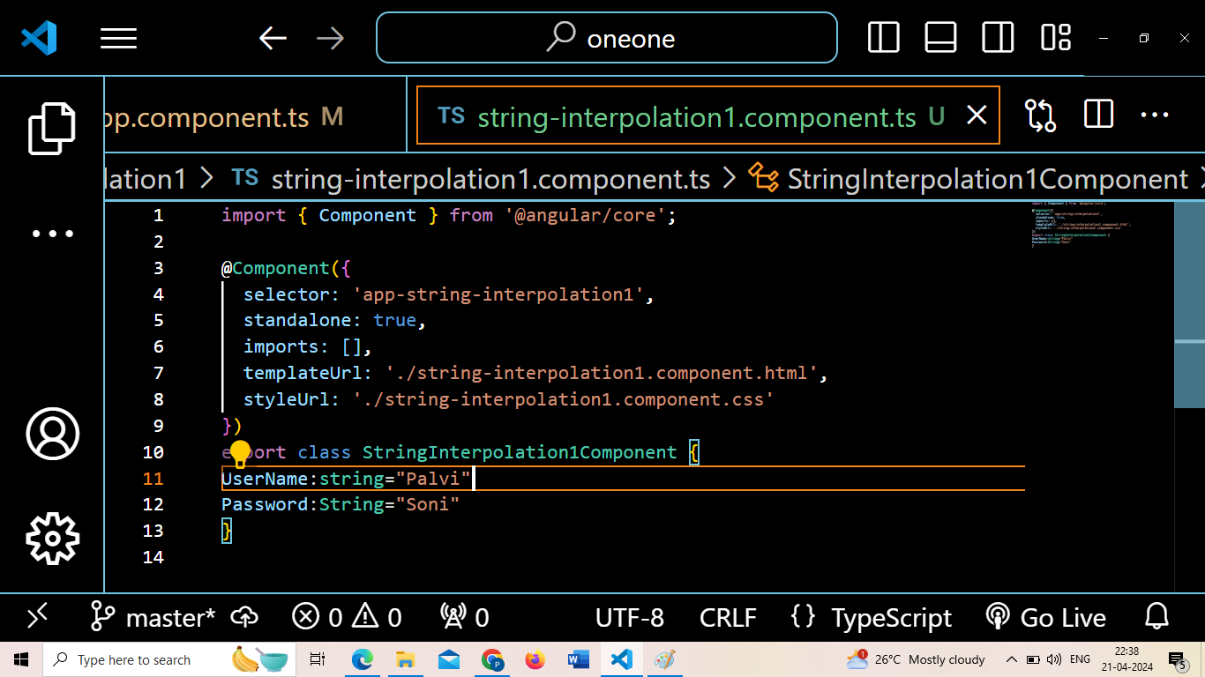
Open stringinterpolation.component.ts

Slide 17
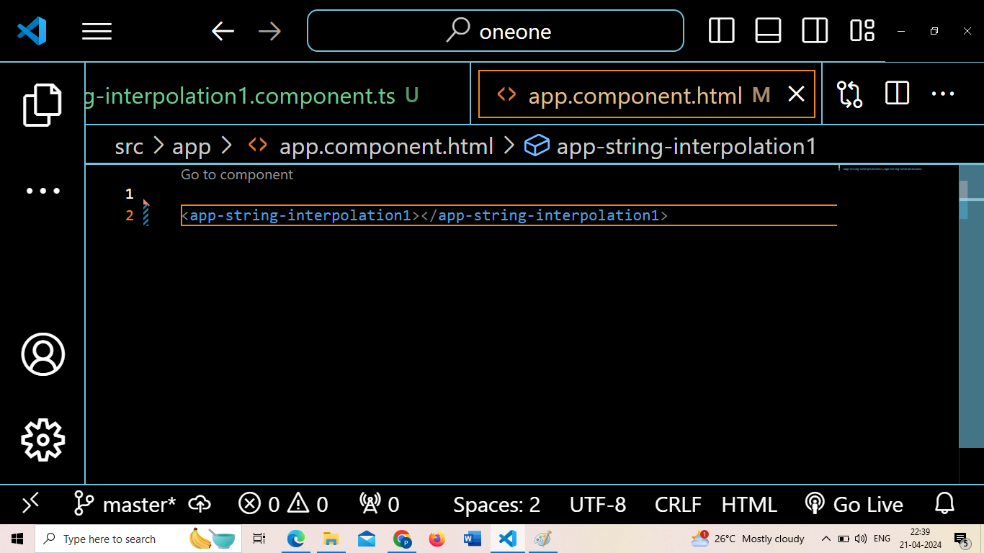
Open app.component.html

Slide 18
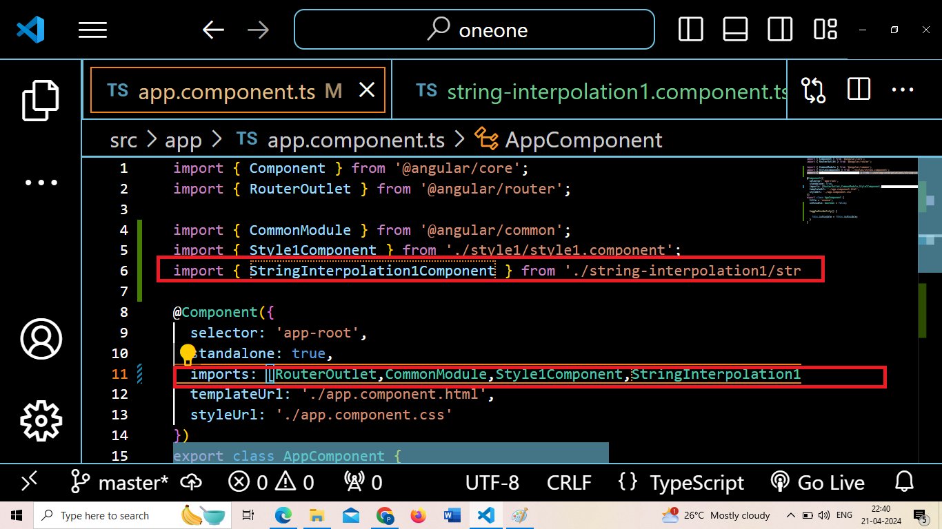
Open app.component.ts- import the necessary components

Slide 19
output

Slide 20
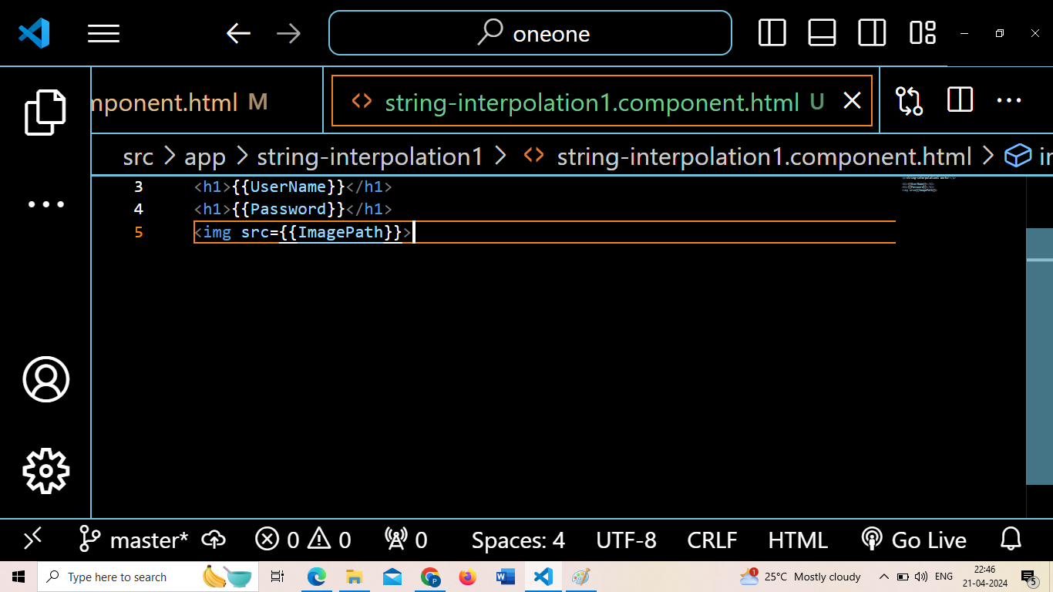
String Interpolation for image

Slide 21
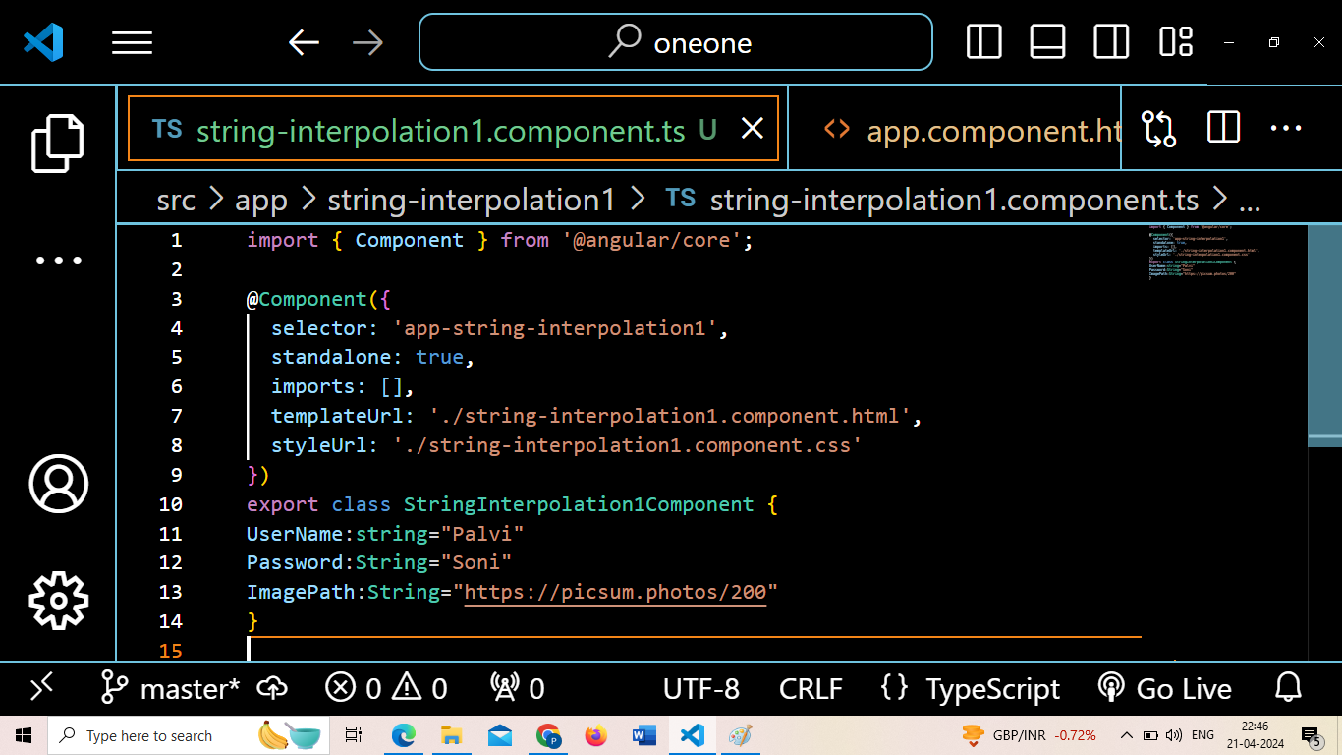

Slide 22
Property Binding
Property Binding is a one-way data-binding technique. In property binding, we bind a property of a DOM element to a field which is a defined property in our component TypeScript code. Actually, Angular internally converts string interpolation into property binding.

Slide 23
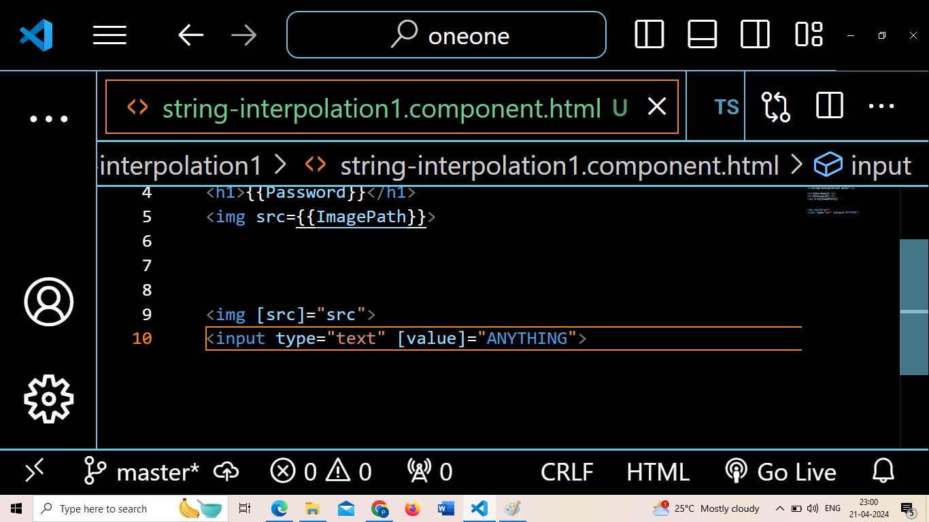

Slide 24
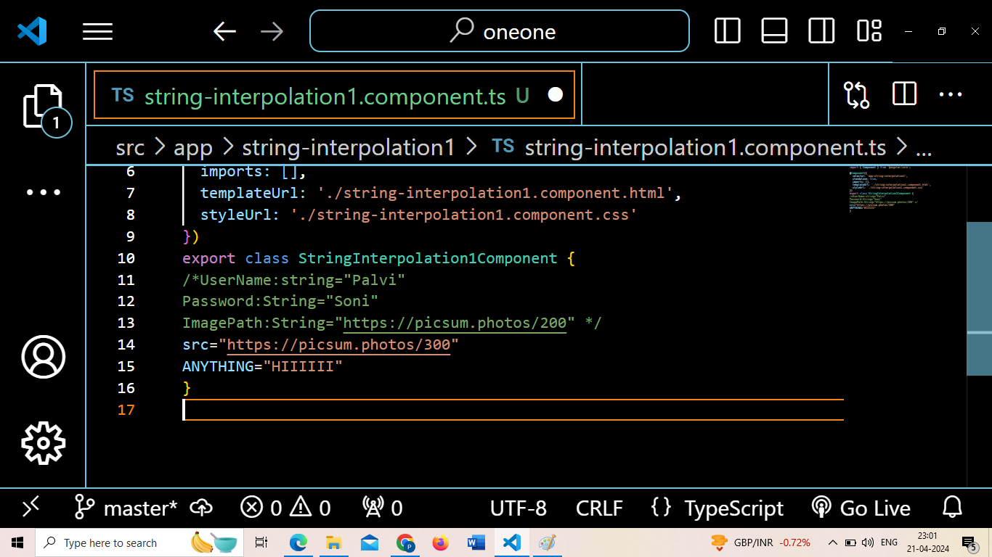

Slide 25
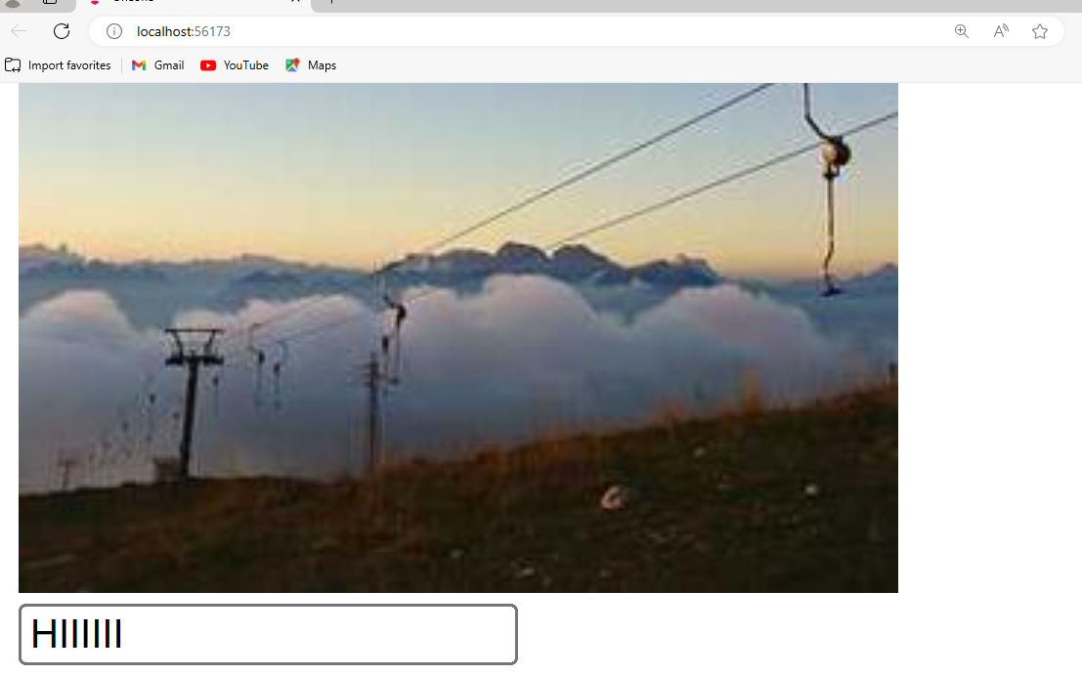
Output

Slide 26
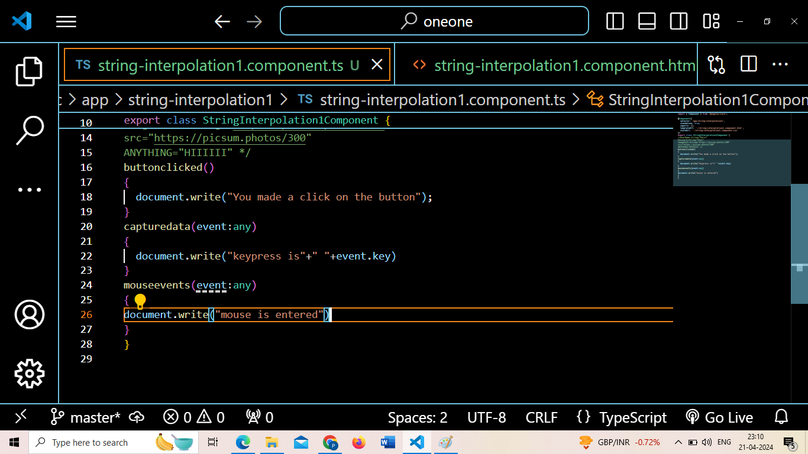
Event Binding

Slide 27
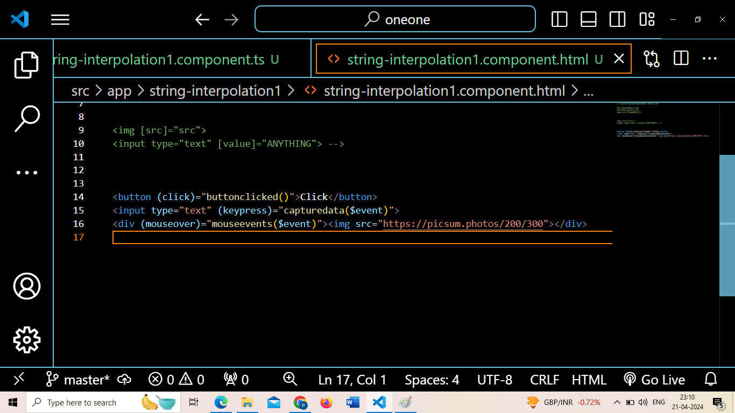

Slide 28
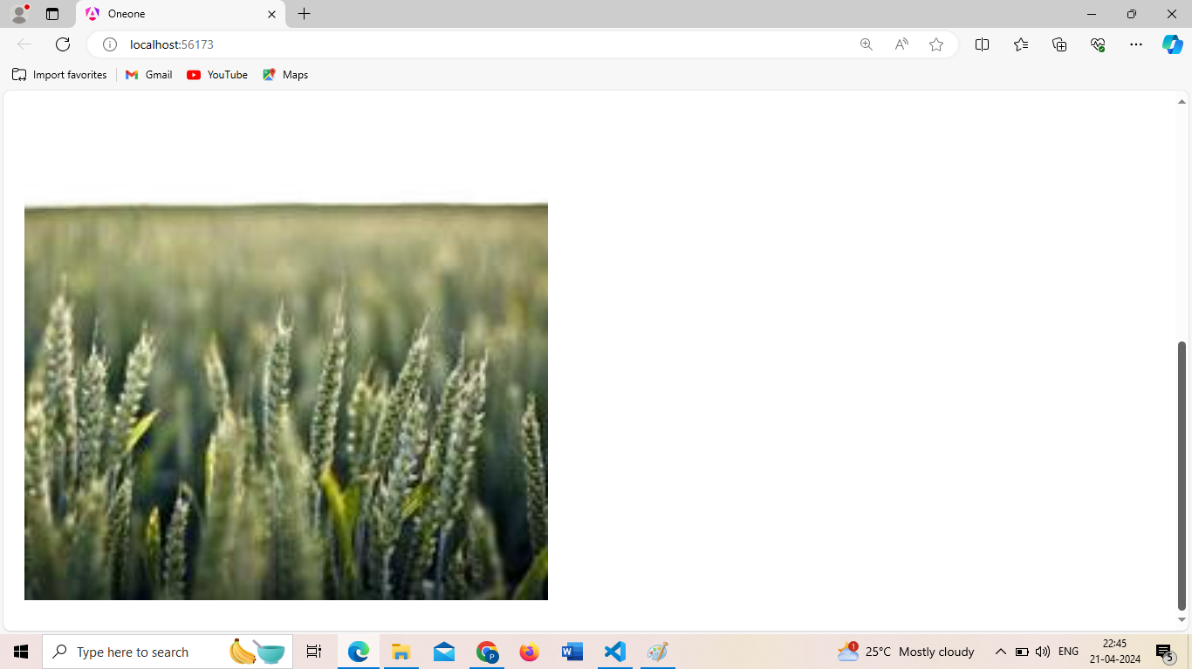

Slide 29
Weekly Activity 12
Create a component with your name, and include two buttons, when you click on first button, the background color of button will changed to “brown”. When you click on the second button,your image will be displayed. Similarly when you make a click on that image, a new text in an input box will be opened, that displays a text “Lets Learn Angular”. Finally when you press a key inside the text box, the text will get vanished. Make use of event binding in your code.

